Slide 1
Types of Plots in Python

Slide 2
bar plots.
histogram.
boxplot.
density plots.
area plots.
scatter plots.
hexagonal bin plots.
pie plots.

Slide 3
Statistical Charts.
Scientific Charts.
Financial Charts.
Maps.
AI and ML.
Visualizing Biological Data.
Subplots.
Animations.

Slide 4
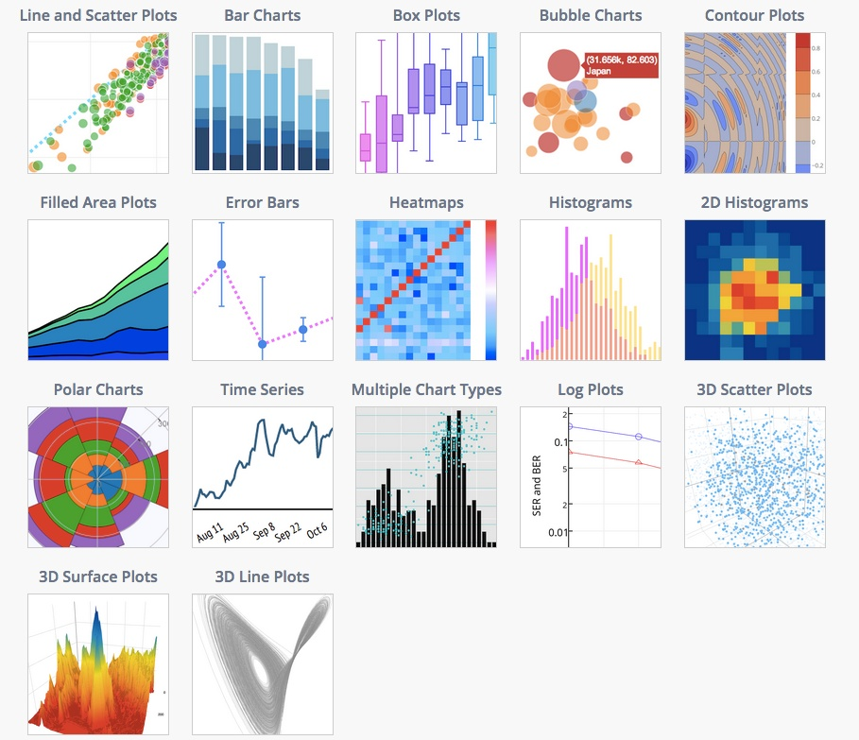

Slide 5
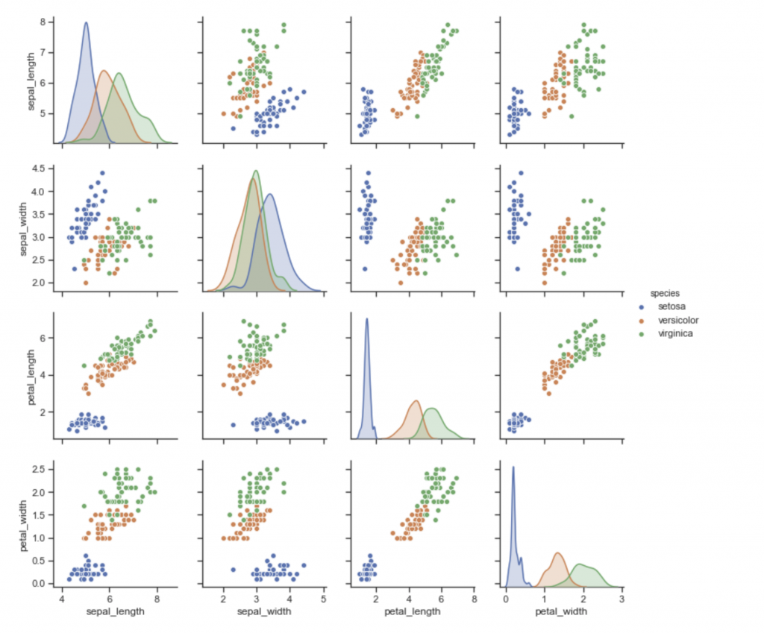

Slide 6
Best Libs to make graphs in Python
Matplotlib
Plotly
Seaborn
GGplot
Altair
Bokeh
Pygal
Geoplotlib

Slide 7
Recommended library for Ploting?
Matplot lib,
Plotly

Slide 8
Can we make the Reports using Viz?
Absolutely Not. You need something more than a typical data visualization tool. With data storytelling, you can communicate a complex dataset more effectively, and convey key information through both visual and textual form. As a result, the audience can better understand important insights.
Anyhow, some type of reports do not need data visualizations e.g. Monthly Distribution reports and bank statement.

